Slide 1
C300 Final Evaluation
Project ID:
SOI-2020-2020-0007
Project Title:
TripAdvisor Data Scraping and Analytics Project
Team ID:
SOI-2020-0005
Team Members:
ALAN LAU TAI LIN
LIEW CHIA YEE
YEE LAI MOI

Slide 2
Agenda
Introduction
Project specification
Project schedule
Task allocation
Data scraping update
Comparison of scraping tools
Scraping steps
Cleanse
Data analysis update
List of questions
Tableau demo

Slide 3
Introduction
Our project is about learning how to scrap data online, explore the data using visualization tool and then learn data analytics and apply on the scraped data.

Slide 4
Project Specification
Part 1: Data Scraping
Guide on scrapping steps and combined scrapped data
Part 2: Data Analytics
Dashboard, a predictive model and a Guide to create and assess the model
Storyboard

Slide 5
Business Analysis
Tripadvisor’s reviews has been decreasing since Covid-19 has affected the tourism sector in Singapore where foreign are barred from entering Singapore for leisure trip.
Restriction on businesses in Singapore such as Circuit breaker, different limitation on phases are also the factors which affected the tourism sector from local.

Slide 6
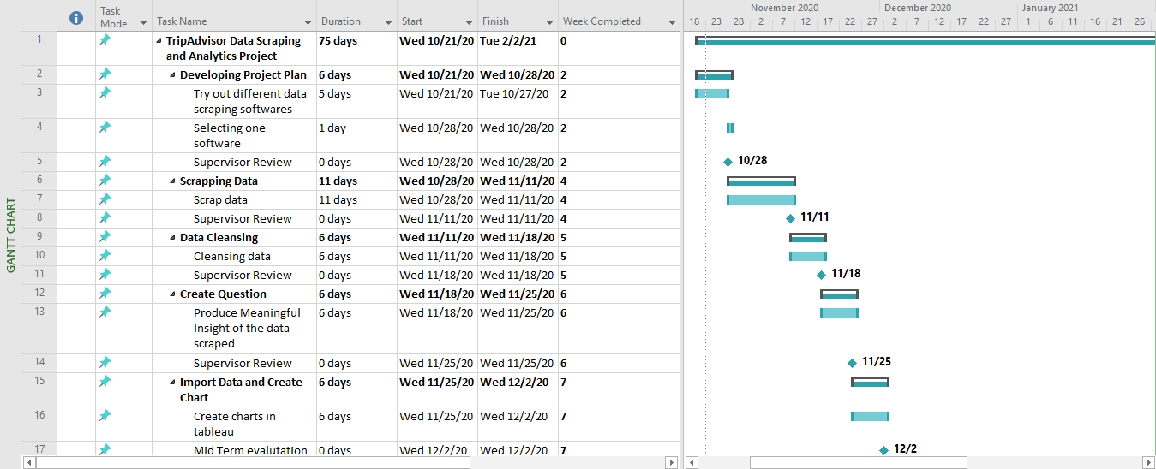
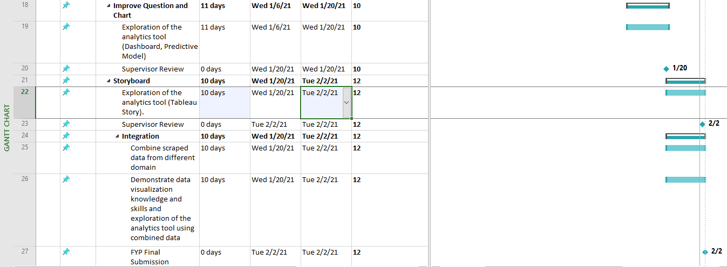
Gantt Chart

Slide 7
Task Allocation and Progress
ALAN Domain: Hotels
Task | Progress
Try out different scraping software (WebHarvy & Scrapstorm) | 100%
Scrap a list of HOTELS from Tripadvisor | 100%
Scrap individual hotel reviews | 100%
Cleanse individual hotel reviews | 100%
Importing data into tableau | 100%
Create questions & chart in tableau | 100%
Improving questions & chart (Research) | 100%
Dashboard story | 100%

Slide 8
Task Allocation and Progress
CHIA YEE
Domain: Restaurants
Task | Progress
Try out different scraping software and choose on one | 100%
Scrap a list of Restaurant from Tripadvisor | 100%
Scrape data from the list of Restaurant | 100%
Cleanse unwanted data | 100%
Create question | 100%
Importing data into tableau and create chart | 100%
Improve question and chart | 100%
Storyboard | 100%

Slide 9
Task Allocation and Progress
LAI MOI
Domain: Attractions
Task | Progress
Try out different scraping software | 100%
Scrap a list of attraction links from tripadvisor website | 100%
Scrap a list of reviews from each attraction link | 100%
Cleanse data | 100%
Import data into Tableau | 100%
Try out different visualisation tools | 100%
Come out with a list of questions | 100%
Charts and Diagrams | 100%
Dashboard | 100%
Story | 100%

Slide 10
Records of Team Meetings with Supervisor
Name | 21/10 | 28/10 | 04/11 | 11/11 | 18/11 | 25/11
Alan | Present | Present | Present | Present | Present | Present
Chia Yee | Present | Present | Present | Present | Present | Present
Lai Moi | Present | Present | Present | Present | Present | Present
Name | 16/12 | 23/12 | 06/01 | 13/01 | 20/01 | 27/01
Alan | Present | Present | Present | Present | Present | Present
Chia Yee | Present | Present | Present | Present | Present | Present
Lai Moi | Present | Present | Present | Present | Present | Present

Slide 11
List of Data Scraping Tools that we tried:
Tools | Pros | Cons/ limitation
ParseHub | No coding required Able to scrap single/ multiple pages | Easily crash/ unresponsive Limited to scrap 5 pages only Limited template Some field selected does not show up
Octoparse | Auto detect data on the URL | Unable to detect TripAdvisor Rating Bubble Based on URL layout
ScrapStorm | Run auto detect on the web | Unable to scrap some of the field. Limited to scrap 100 rows per days.
WebHarvy | Scrap base on the layout of the page. Select the fields needed only Multiple page scraping Online tutorials for Tripadvisor Student License available (unlimited pages per scrap) | Free Trial limited 2 pages per scrap.
Chosen

Slide 12
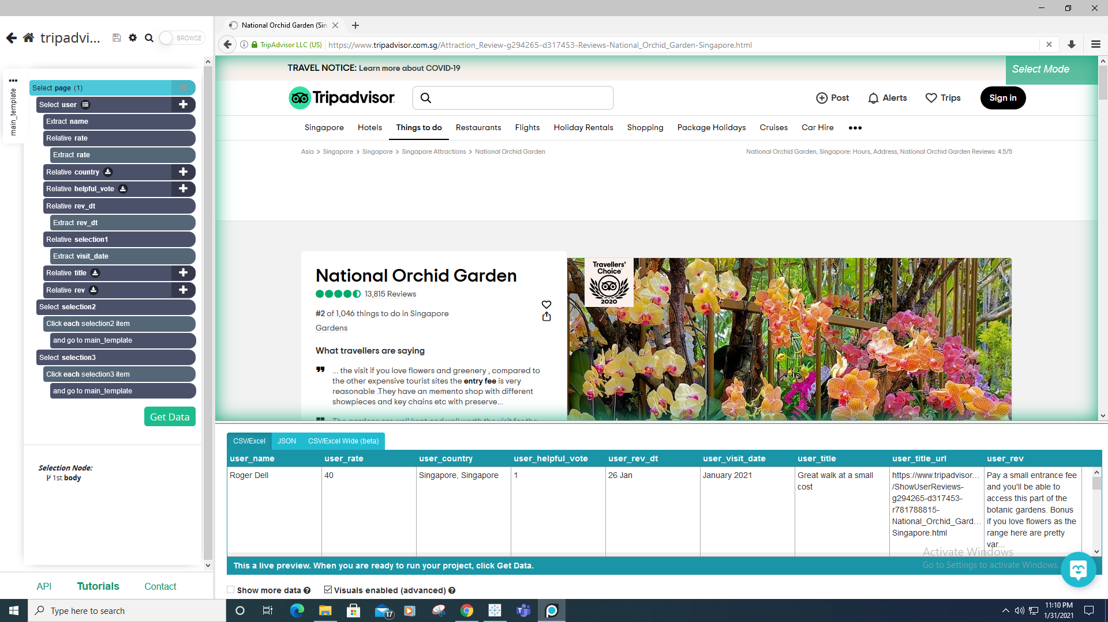
ParseHub

Slide 13
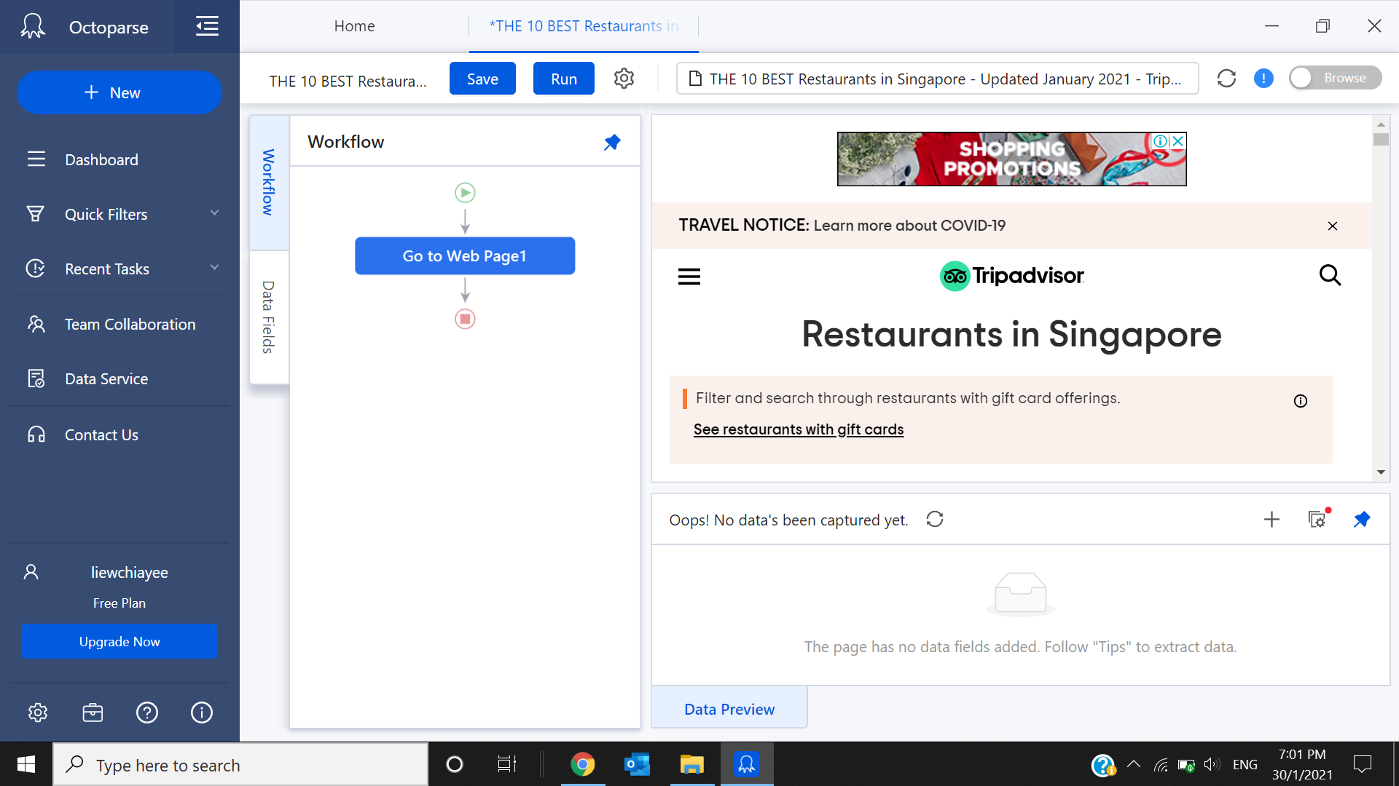
OctoParse

Slide 14
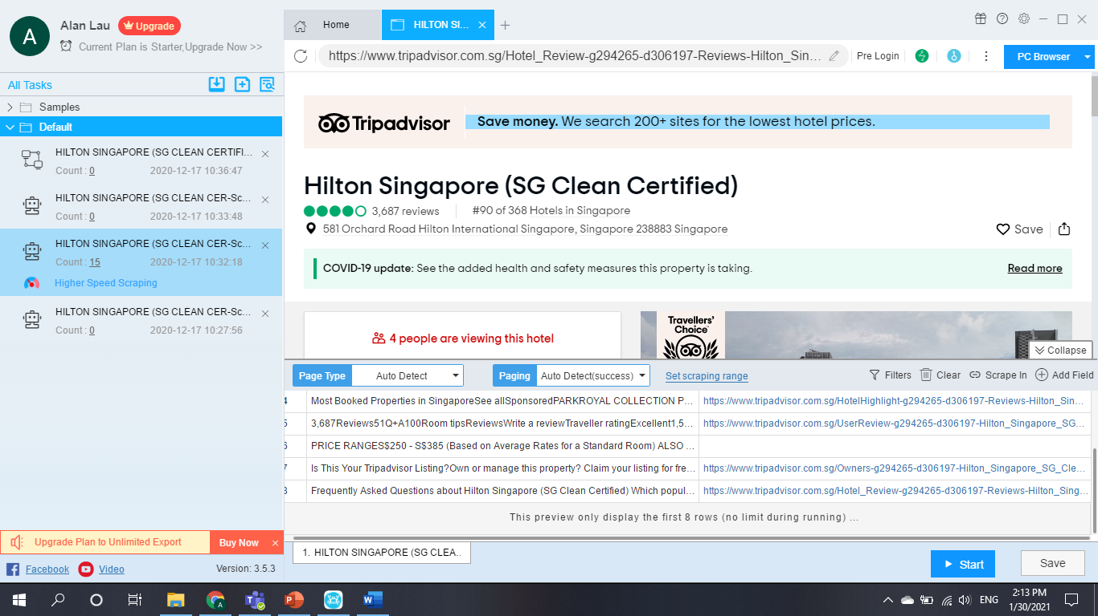
Scrapstorm

Slide 15
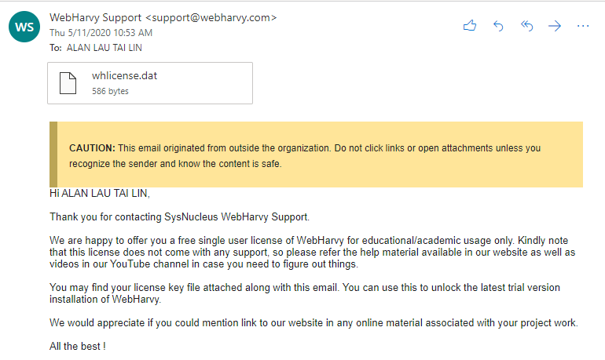
Student’s License from WebHarvy

Slide 16
Prototype Walk Through / Demonstration
Scraping data from TripAdvisor
Cleansing of data
Tableau Dashboard Story

Slide 17
Data Scraping (WebHarvy)
PRESENTATION

Slide 18
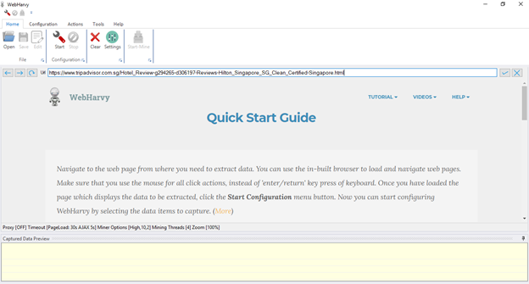
Data scraping (TripAdvisor webpage)
ENTER URL

Slide 19
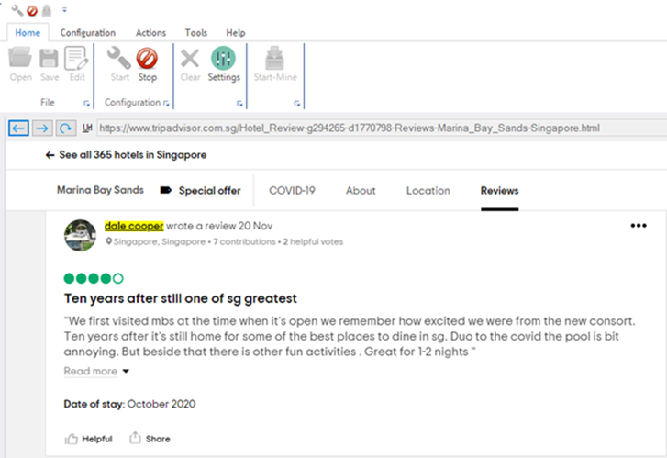
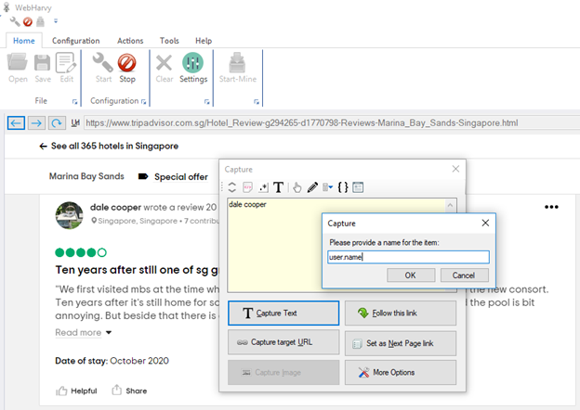
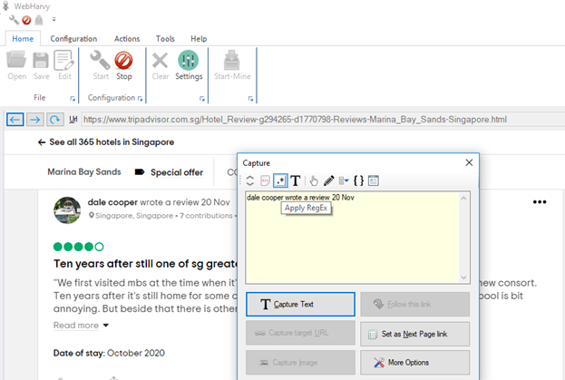
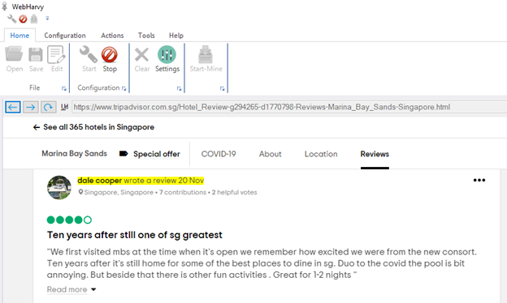
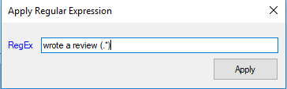
Data scraping (Username & Review Date)

Slide 20
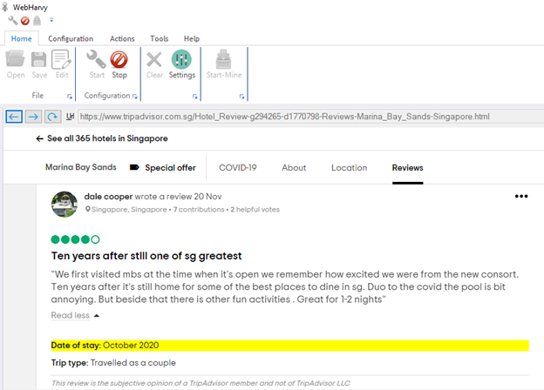
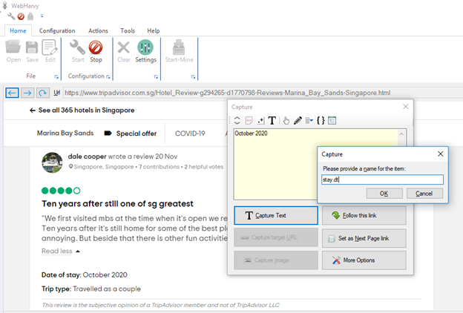
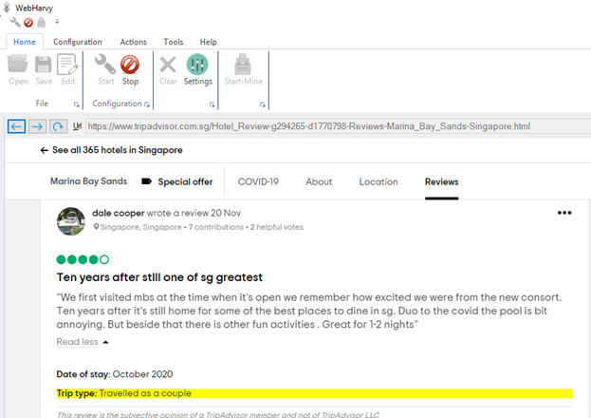
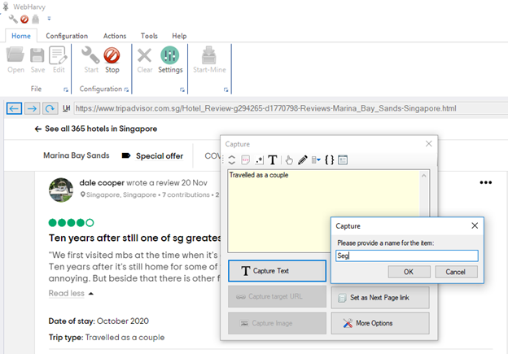
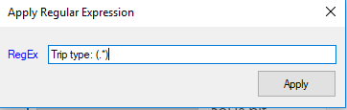
Data scraping (Visit Date & Travel Types)

Slide 21
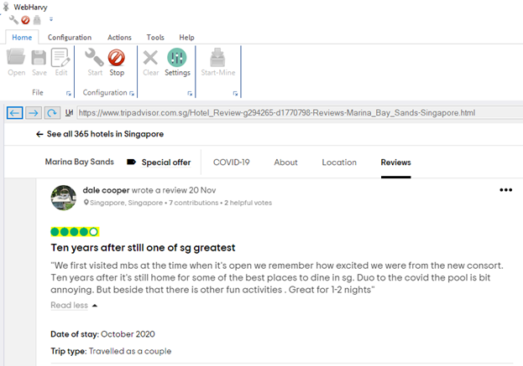
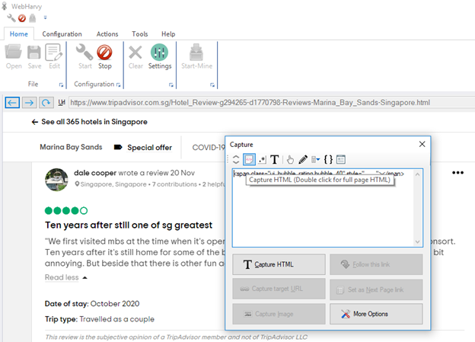
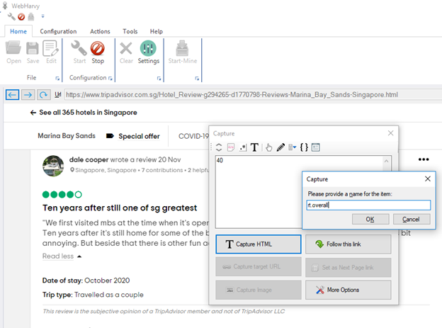
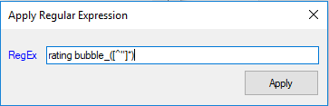
Data scraping (User Rating)

Slide 22
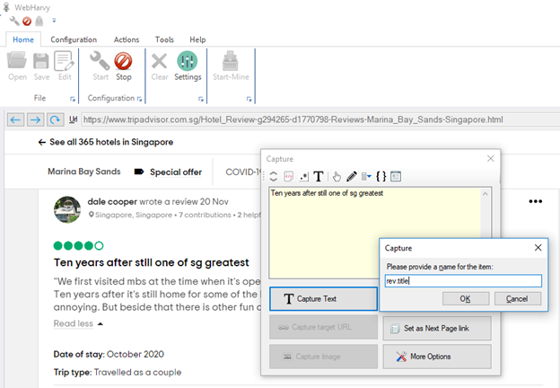
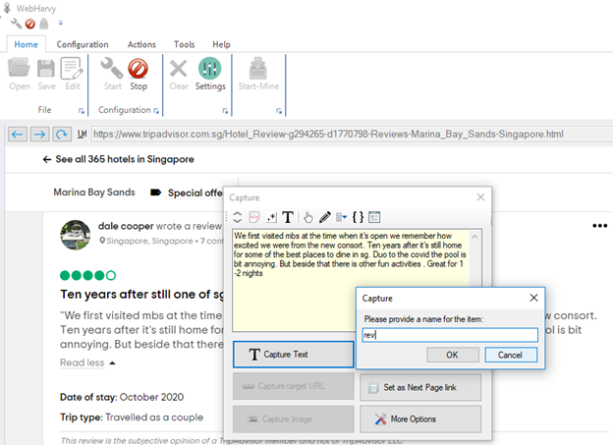
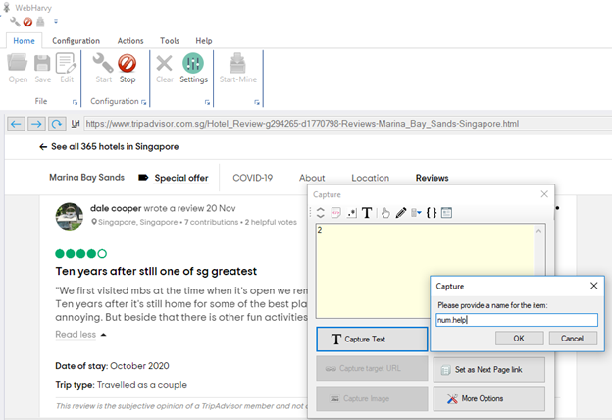
Data scraping
(Review Title, reviews & Helpful votes)

Slide 23
Data Cleansing

Slide 24
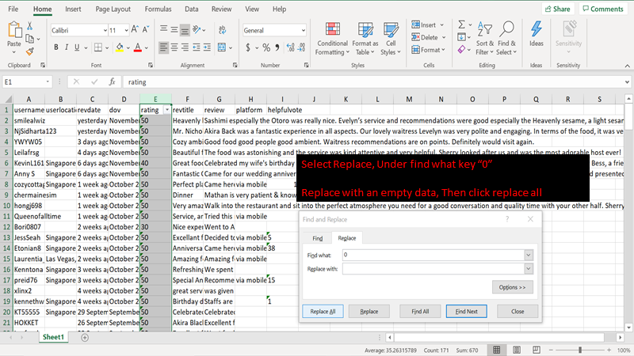
Data Cleansing (User Rating)
Converting the overall rating from
e.g.
50 (raw)
to
5 (cleanse)

Slide 25
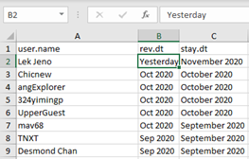
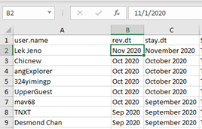
Data Cleansing (Review Date)
Convert raw data (e.g. Yesterday, 1 days ago, 2 weeks ago) to MMM YYYY format

Slide 26
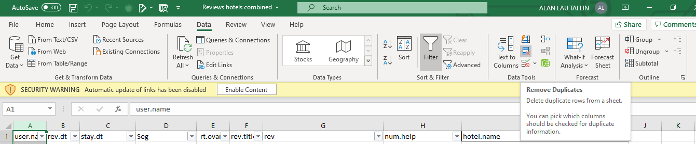
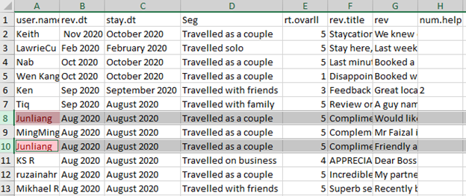
Data Cleansing (Duplicate User Reviews)
Remove duplicate reviews

Slide 27

Hotel
Consist of:
Total Hotels Scraped: 56
Total rows of data retrieved: 54,151
18 types of data
(Hotel name, Hotel overall rating, Hotel location rating, Hotel cleanliness rating,Hotel service rating ,Hotel Value rating,Hotel Link,Hotel Location, username, user location, Reviewed date, stay date,user rating, review title, review, Helpful vote, Travel type)

Slide 28

Restaurant
Consist of:
Total Restaurant Scraped: 60
Total rows of data retrieved: 32,005
14 types of data
(Restaurant, Cuisine, Restaurant Rating, Total Review, Address, Username, User Location, User Rating, Reviewed Date, Date of Visit, Review Title, User Review, Cost, PostalCode)

Slide 29

Attraction
Consist of:
Total Attractions Scraped: 26
Total rows of data retrieved: 38,953
16 types of data
(Attraction Name, Total number of review, Attraction Type, Overall Rating, Attraction Address, Attraction Link, Ranking, Postal Code, User Rating, User Name, User Location, Helpful Vote, Reviewed Date, Date of Visit, Review Title, User Review)

Slide 30
Tableau Story
PRESENTATION

